Slide 1
Integration of Third-Party Smart Locks into the Smart Home System
Aleksandar Zagorac and Marija Antic

Slide 2
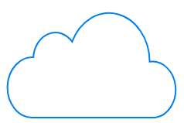
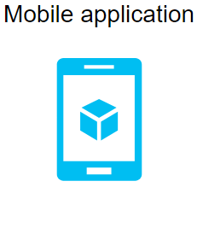

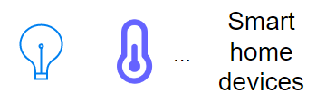

SMART HOME CLOUD
THIRD PARTY CLOUD
GATEWAY
GATEWAY
SMART LOCK

